Slide 1


A PROTOTYPE OF AUTONOMOUS ROBOT OF LOOSE FRUIT COLLECTOR(ARLFC) FOR PALM OIL PLANTATION
Department of Electrical and Electronic Engineering
Faculty of Engineering
Universiti Putra Malaysia
43400 UPM Serdang, Selangor Darul Ehsan, Malaysia

Slide 2
Project title: Autonomous Robot Loose Fruit Collector
FUNCTION/PURPOSES
Able grasp the bunch of palm oil automatically
Apply to non skill workers/local
Able to improve total yield
WORKING CONCEPT/PRINCIPLE
Modify the existing tractor grabber (cost)
Apply proportional controller system to existing manual grabber without modifying existing system(Estimate hybrid mechanization system)
Assemble and install outdoor camera system for applying bunches image detection method
Type of Product – POC, Period – 6-12 months and Estimation Cost - RM100k – RM150k
MACHINE PERFORMANCE
Accurate and faster (cover 40-50 hectares/day(24 hours)) – double compare to existing method
Applied for non skill workers not limited to man workers only(Solve skill workers requirements and ladies also can do the job)
Applied for local labors either man or ladies (Solve shortage foreign labors – Sime Darby shorts ~ 5000 workers in 2020)

Slide 3

Project title: Automatic Tractor Grabber for Palm oil Plantation
Researcher
Assoc Prof. Dr. Wan Zuha Wan HAsan
Research Associate
Laboratory of Plantation System Technology & Mechanization
Universiti Putra Malaysia
FUNCTION/PURPOSES
Able grasp the bunch of palm oil automatically
Apply to non skill workers/local
Able to improve total yield
WORKING CONCEPT/PRINCIPLE
Modify the existing tractor grabber (cost)
Apply proportional controller system to existing manual grabber without modifying existing system(Estimate hybrid mechanization system)
Assemble and install outdoor camera system for applying bunches image detection method
Type of Product – POC, Period – 6-12 months and Estimation Cost - RM100k – RM150k
MACHINE PERFORMANCE
Accurate and faster (cover 40-50 hectares/day(24 hours)) – double compare to existing method
Applied for non skill workers not limited to man workers only(Solve skill workers requirements and ladies also can do the job)
Applied for local labors either man or ladies (Solve shortage foreign labors – Sime Darby shorts ~ 5000 workers in 2020)

Slide 4



INTRODUCTION
In this proposal, we propose a prototype ARLFC to improve the loose fruit collection at this plantation. The prototype robot able to navigate autonomously through the plantation field using smart navigation system (SLAM) and detecting the loose fruit using AI (OPEN POSE) as well as collecting the loose fruit using smart vacuum system which is second major part of the ARLFC. Based on these, we estimate that total number of loose fruits that able to be collected per suction is 100 loose fruits in every minute autonomously.
Notes:
© Copyright PresentationGO.com – The free PowerPoint template library

Slide 5
METHODOLOGY
START
Apply Husky Robot for Navigation, Object recognition in the Plantation
Apply custom smart vacuum system for collecting the Loose fruit as required performance
Integrate the Husky robot system, and smart vacuum system
Test, Verify and Analysis the performance of ARLFC
END
Notes:
© Copyright PresentationGO.com – The free PowerPoint template library

Slide 6
ARLFC
Phase 1. Base System (Husky Robot)
Navigation and Object Recognition
Autonomous Mapping System
Scan the environment
Image processing
Emptying the consignment
Charging
For this task we need some equipment’s such as 3D scanner, GPS, RGBD camera and vacuum system. And for software we use SLAM for mapping and scanning, and programming with Matlab, C++ and Python.
Notes:
© Copyright PresentationGO.com – The free PowerPoint template library

Slide 7
ARLFC
Phase 2. Custom Vacuum System
Specification:
The blower use 12vdc/80w power
cylinder shape with diameter 25cm and 30 cm height
Estimated 200 loose fruit can be stored at a time
The nozzle angle is 45 degree
Notes:
© Copyright PresentationGO.com – The free PowerPoint template library

Slide 8
METHODOLOGY
Phase 3. Integration of Base system and Vacuum system for real time application
The project will be carried out by 6 academic staffs and 10 postgraduate students at Robotic Lab in UPM and for the filed testing, it will done at the Carey island where the Sime Darby plantation located.
We estimate the collecting the loose fruit are more fast and efficient compare to the conventional way that been used today on their loose fruit collector machine. In this phase, the husky base system comprises with autonomous system that integrated with smart vacuum system that enables the robot to move to specified location on the plantation and collect the loose fruit.
The performance of ARLFC will be analysed and conducted in real-time application.
Notes:
© Copyright PresentationGO.com – The free PowerPoint template library

Slide 9
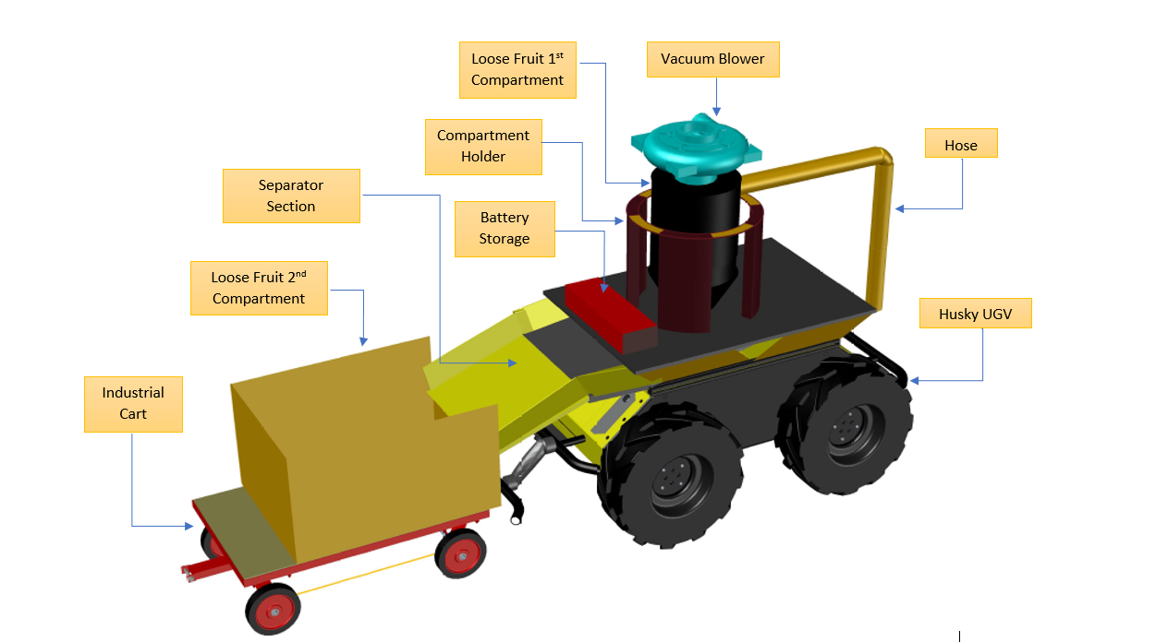
ARLFC

Slide 10
RESEARCHERS
Researches | Research Area
Prof. Ir. Dr Mohd Zainal Abidin Abd Kadir (Advisor) | Project Management
Prof Madya Dr Ts Wan Zuha Wan Hasan (Leader) | Robotic/ROS
Prof Madya Dr Norhafiz Azis | Power Electronic
Dr Hafiz Rashidi@Harun | Robotic/Image Processing
Dr Mohd Nazim Mohtar | Electronic
Dr Nasri Sulaiman | Electronic
Dr. Ahmad Fikri Abdullah | Agriculture Engineering
Postgraduate
5 PhD | Robotic/AI
5 MSc | Robotic/AI
Notes:
© Copyright PresentationGO.com – The free PowerPoint template library

Slide 11
Gant Chart
Notes:
© Copyright PresentationGO.com – The free PowerPoint template library

Slide 12

Terima Kasih | Thank You

